Slide 1
FINANCIAL ANALYTICS
FINAL PROJECT
SUBMITTED TO : HARPREET VIRK
SUBMITTED BY : SEONG KYOUNG – 0725164
: TEJAS MAHESH PATEL – 0734912
: SOORYA SURESH – 0735168
: RAJWINDER KAUR – 0732989
: YI ZHOU – 0730368
: MOHSIN MEGHJANI - 0730241

Slide 2
CRYPTOCURRENCY PRICE PREDICTION USING MACHINE LEARNING

Slide 3
INTRODUCTION
Recent growing interest in cryptocurrencies have sparked a global conversation over the past months.
Although this data is available across various sites, there is a lack of understanding as to what is driving the exponential rise of many individual currencies.
This data set is intended to be a starting point for a detailed analysis into what is driving price action, and what can be done to predict future movement.

Slide 4
ABOUT THE DATSET
The csv file contains consolidated financial information for the top 200 cryptocurrencies by market cap. Pulled from CoinMarketCap.com.
Attributes include:
Currency name (e.g. bitcoin)
Date
Open
High
Low
Close
Volume
Market cap

Slide 5
WORKS ON PYTHON
At first we imported necessary libraries and read the dataset
There are 28944 rows and 8 columns
There was no null values in our dataset
Converted the close column which was in integer type to float
The Date column was in object type so to use it for time series we converted it to index by using datetime function

Slide 6
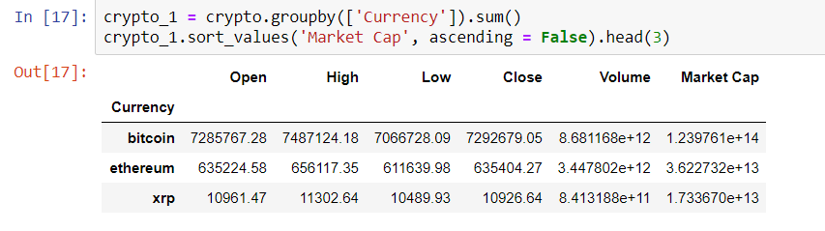
DATA ANALYSIS
Filtered Top 3 crypto currency from the data based on market cap which are Bitcoin, Ethereum and XRP

Slide 7
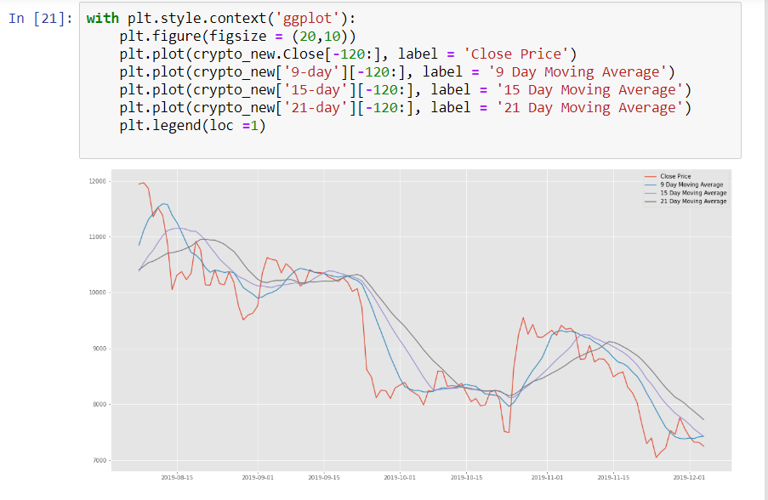
BITCOIN MOVING AVERAGE
First, we filtered out Bitcoin cryptocurrency
Find out moving average of Bitcoin for 9, 15 and 21 days
From the graph we can see that it shows a downward trend and seasonality in it.
9 day moving average is closest to original close value

Slide 8
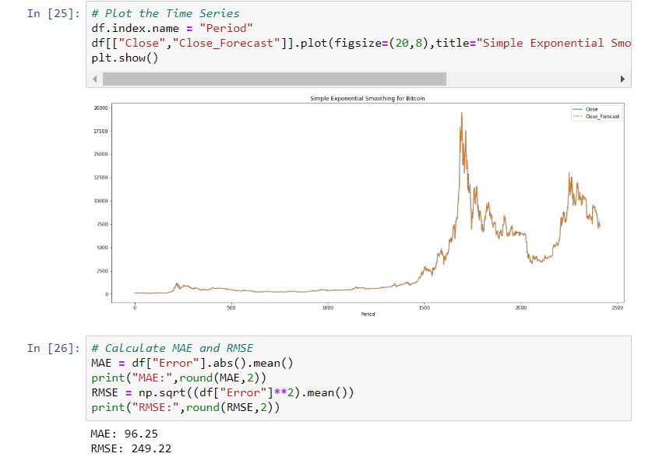
SIMPLE EXPONENTIAL SMOOTHING
By using the data solver in excel we found the alpha value which gave us the lowest RMSE of 249.22

Slide 9
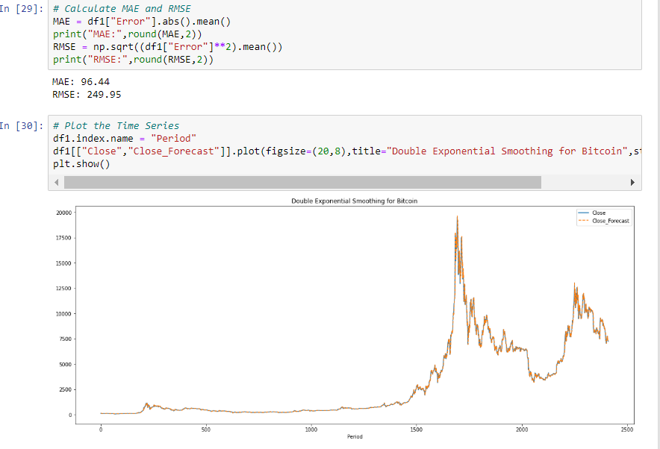
DOUBLE EXPONENTIAL SMOOTHING
By using the data solver in excel we found the alpha value which gave us the lowest RMSE of 249.95
So we wont be using the DES because RMSE value is high. Hence it wont be of any use

Slide 10
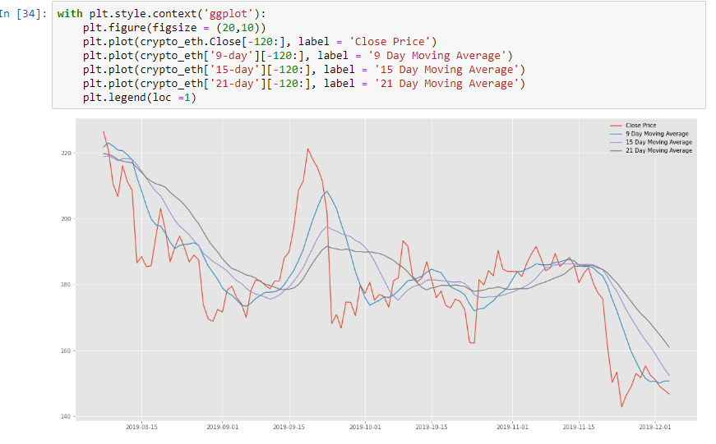
ETHEREUM MOVING AVERAGE
From the graph we can see that it shows a downward trend and seasonality in it.
Find out moving average of Bitcoin for 9, 15 and 21 days
9 day moving average is closest to original close value

Slide 11
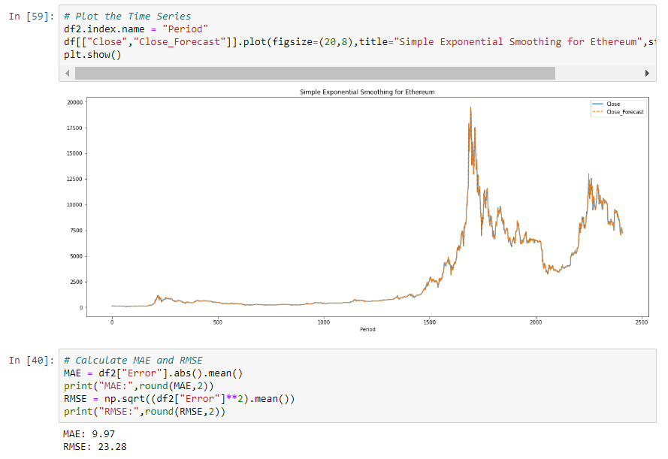
SIMPLE EXPONENTIAL SMOOTHING
By using the data solver in excel we found the alpha value which gave us the lowest RMSE of 23.28

Slide 12
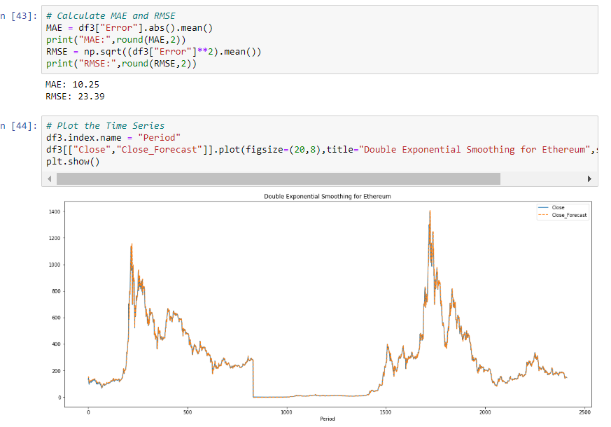
DOUBLE EXPONENTIAL SMOOTHING
By using the data solver in excel we found the alpha value which gave us the lowest RMSE of 23.39
So we wont be using the DES because RMSE value is high. Hence it wont be of any use

Slide 13
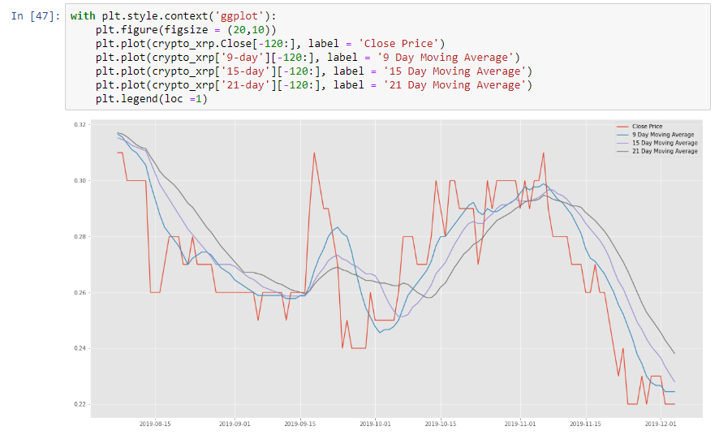
XRP MOVING AVERAGE
From the graph we can see that it shows a downward trend and after some time showing upward trend and seasonality in it.
Find out moving average of Bitcoin for 9, 15 and 21 days
9 day moving average is closest to original close value

Slide 14
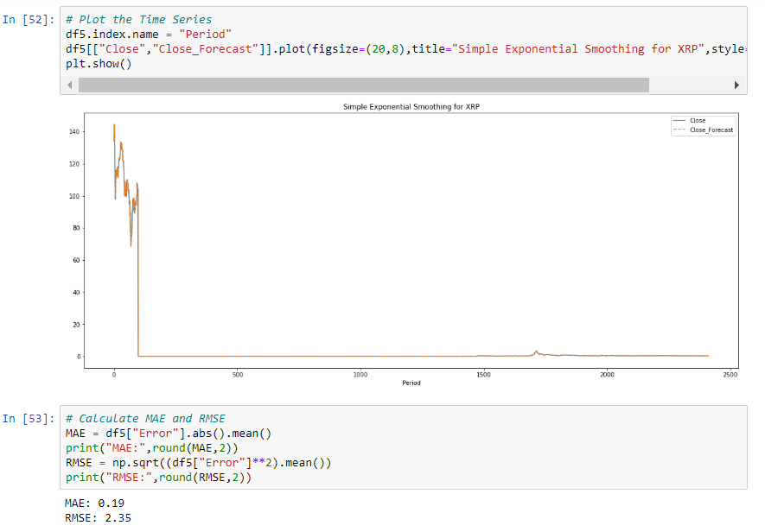
SIMPLE EXPONENTIAL SMOOTHING
By using the data solver in excel we found the alpha value which gave us the lowest RMSE of 2.35

Slide 15
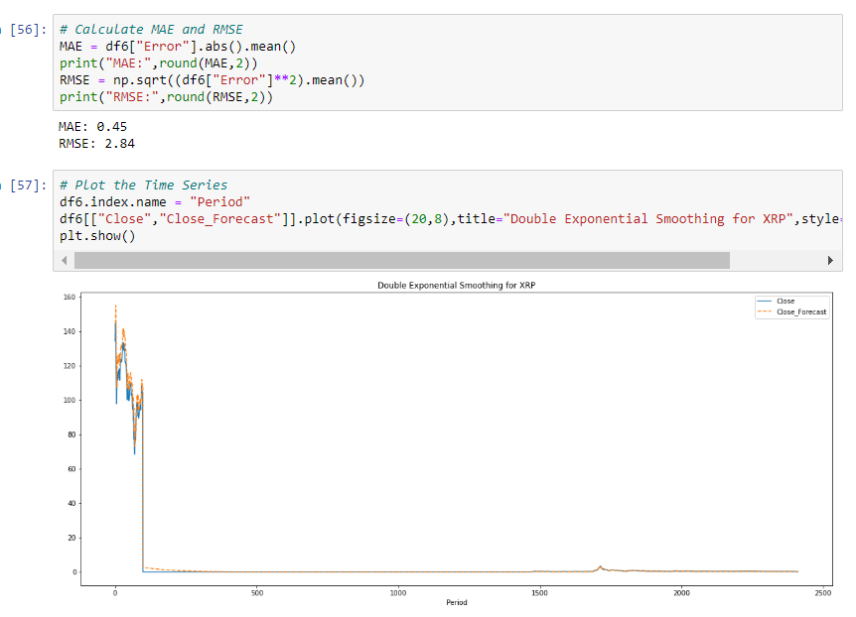
DOUBLE EXPONENTIAL SMOOTHING
By using the data solver in excel we found the alpha value which gave us the lowest RMSE of 2.84
So we wont be using the DES because RMSE value is high. Hence it won’t be of any use

Slide 16
NEURAL NETWORK - LSTM
At first, we imported necessary libraries and read the dataset.
We scaled the dataset.
We did LSTM work on two prices Bitcoin and Ethereum.

Slide 17
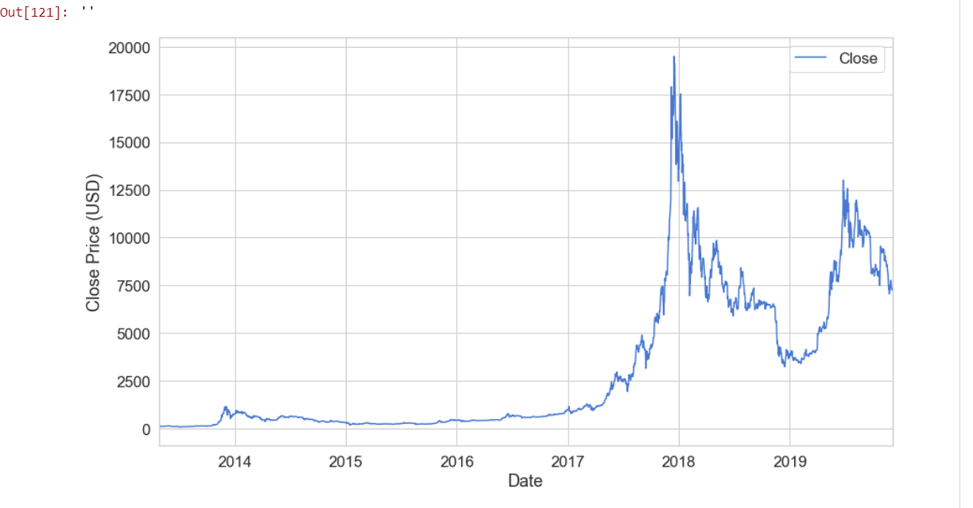

BITCOIN PRICE CHART
We can clearly see, In the Bitcoin Closing Price chart the USD dollar price 2014 to 2017 was remained same.
After 2017 it raised sharply and reached at their peak point.
2018 it again declined and little bit increased in 2019.

Slide 18
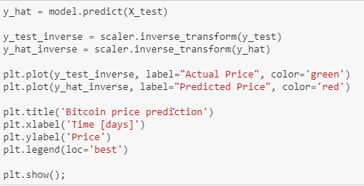
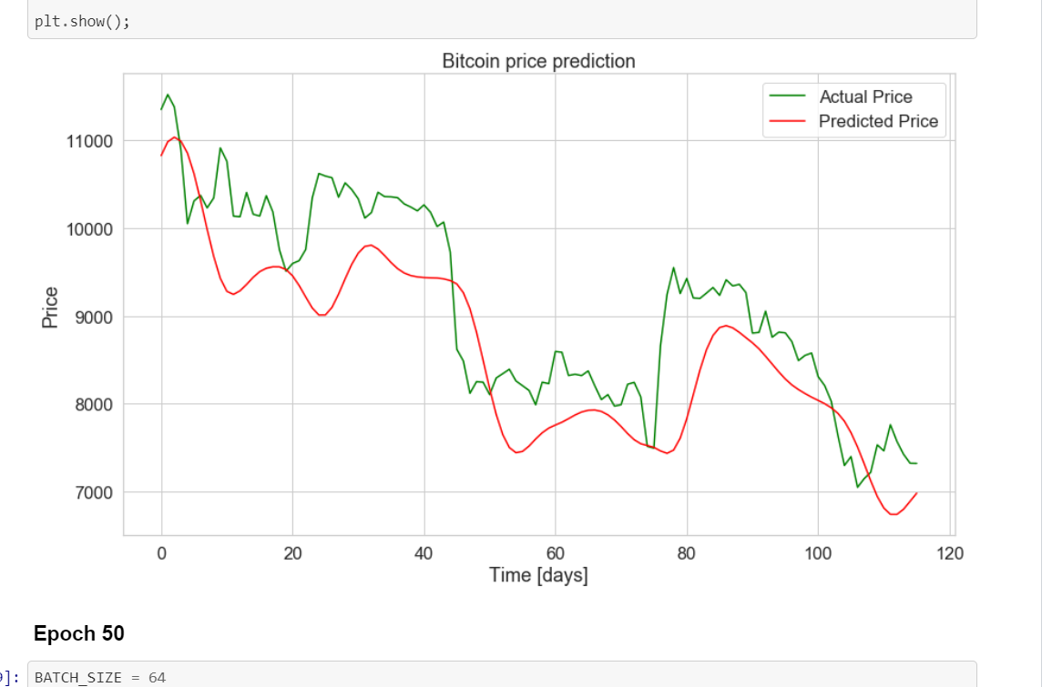
BITCOIN EPOCH15
In the Bitcoin epoch_15’s graph we can see all the time period Actual Price was higher compare to the Predicted Price.
According to there overall performance both prices our decreased after there first day.

Slide 19
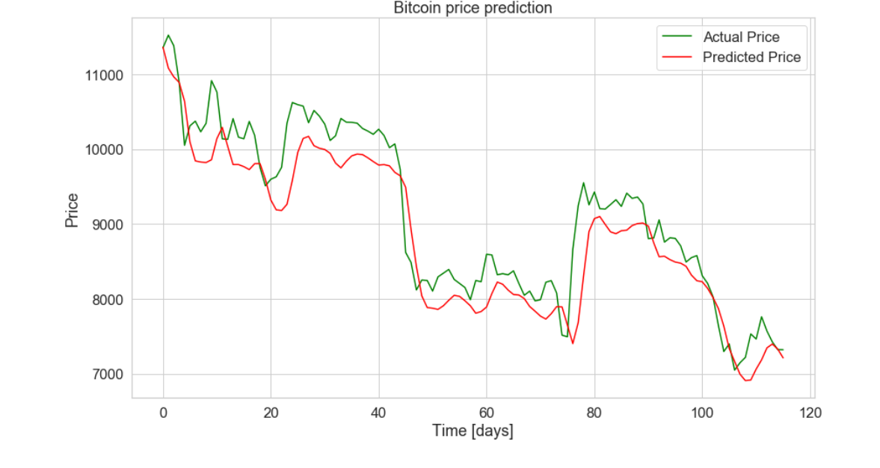
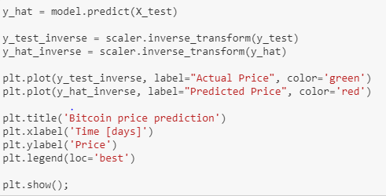
BITCOIN EPOCH 50
In the graph epoch 50 in the Bitcoin Price Prediction in there starting days Actual price was higher and Predicted price lower
After that there were some ups and downs in both prices.
Both prices decreased after the 20th day and at the end of the day Actual price was higher n the graph.

Slide 20
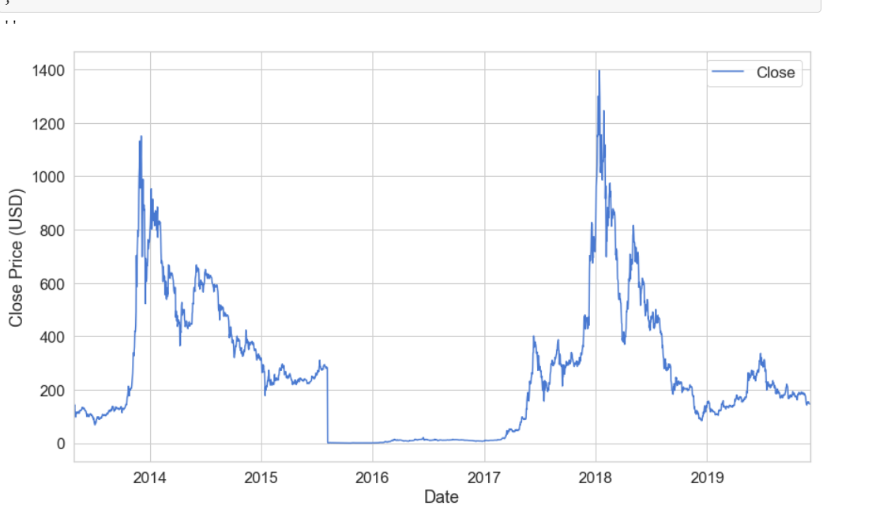
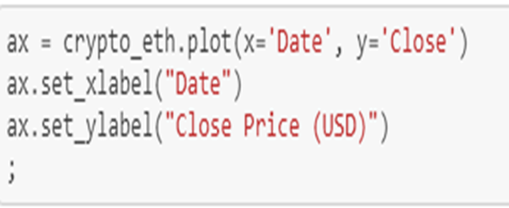
ETHEREUM PRICE CHART
In the Ethereum price chart, In 2014 the closing price of USD dollar is increased and then in the next year it decreased slowly.
In 2016 to 2017 it was remain same but in 2018 the price was on there peak point and again we can see the price was falling off.

Slide 21

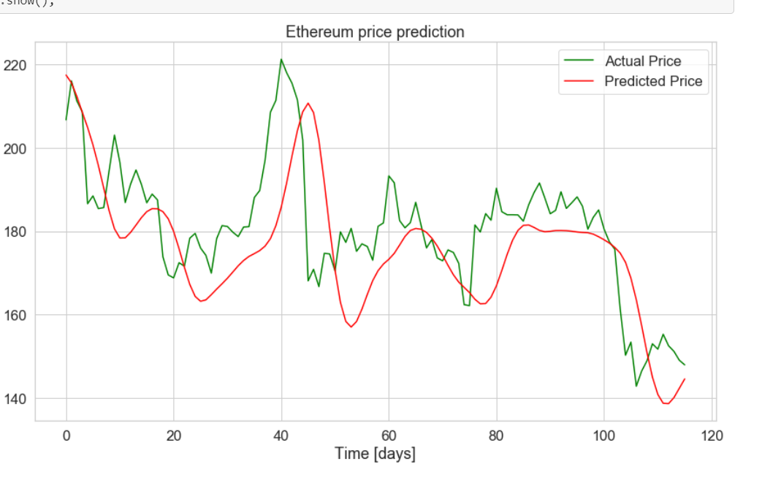
ETHEREUM EPOCH15
In the graph, the epoch_15 we can see, the at the starting day Actual price is lower than Predicted price.
On the 40th day, it reached on there peak point and after then both prices fluctuated. The day between 110th to 120th the actual price is high where as Predicted price less

Slide 22
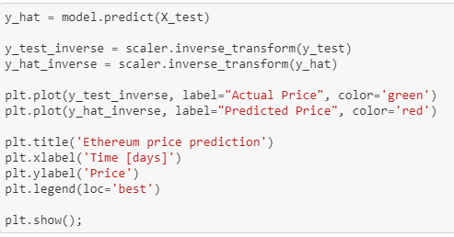
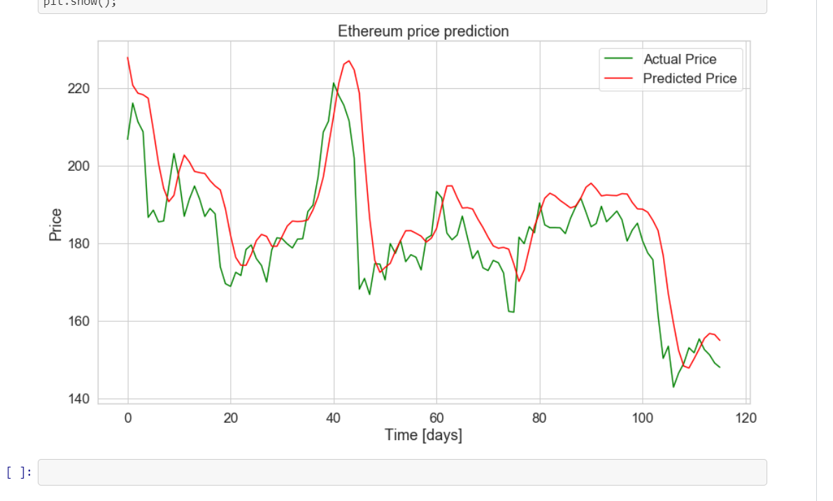
ETHEREUM EPOCH 50
In the chart, we can see in the epoch 50 the Actual price is low in the beginning days and Predicted Price is high.
After that both prices our fluctuated and on 40th day both prices our on there peak point but predicted price still high then actual price.
In the next day both prices our decreased.

Slide 23
CONCLUSION
All the models are able to predict the close price of market price
Cryptocurrency market is the high volatile market
In the real world the top cryptocurrencies are Bitcoin, XRP and Ethereum
The cryptocurrency market runs 24hrs
From our research(not based on dataset), we found that most volatile period is between 3-4 pm
Cryptocurrency itself is a working market right now. Hence even if stock market go down cryptocurrency wont. They are based on their mining and demand
Currently Bitcoin jumped to a good price because there are less miners and demand is high

Slide 24
REFERENCE
Dataset link Kaggle:
https://www.kaggle.com/philmohun/cryptocurrency-financial-data
Research link: https://www.forbes.com/sites/forbesdigitalassets/2019/10/02/bitcoin-volatility-by-time-period/#4ee30871c733

